Slide 1
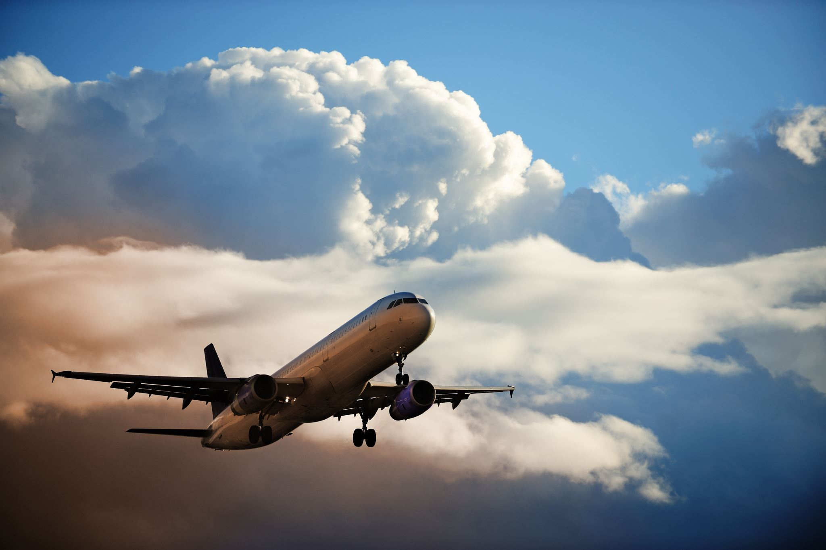
Airline Industry Analysis - Executive Summary
By: Evelyn Cates
DSC 640- Data Preparation & Visualization

Slide 2
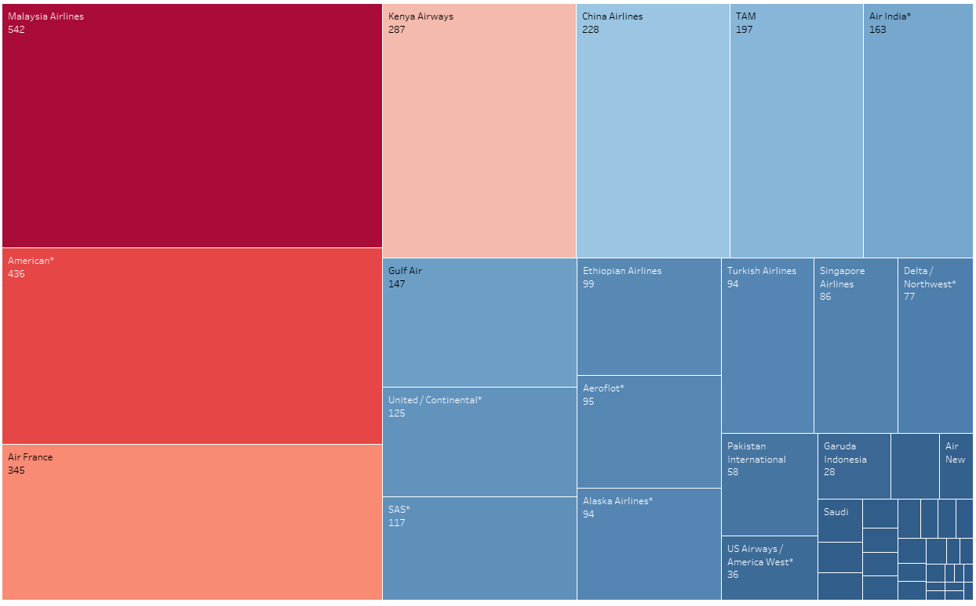
Total Incidents Per Airline from 2000-2014
Notes:
Total Incidents Takeaways:
Malaysia Airlines had the most incidents across all airlines
In the top 20 airlines with incidents only 4 of those were US airlines.
US airlines are low in the list with incidents

Slide 3
US Airline Incidents Comparing 1985-1999 to 2000-2014
Notes:
US Airline Incidents 85-99 & 00-24 Takeaways:
US airline incidents have decreased by 34% from the time period of 1985-1999 to 2000-2014

Slide 4
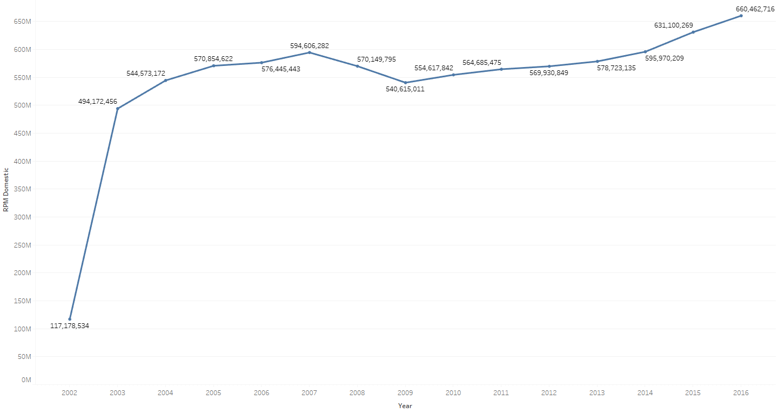
Yearly Revenue Per Domestic Miles
Notes:
Yearly Revenue Domestic Miles Takeaways:
Airline revenue is steadily increasing YOY. The years with lower revenue can be explained with incidents happening in our country. After 9/11 a drastic cut in air travel decreased resulting in less revenue for 2002. In 2009 there was an economic recession. Even after the recession, there was a 2.5% increase in revenue and has continued to increase.

Slide 5
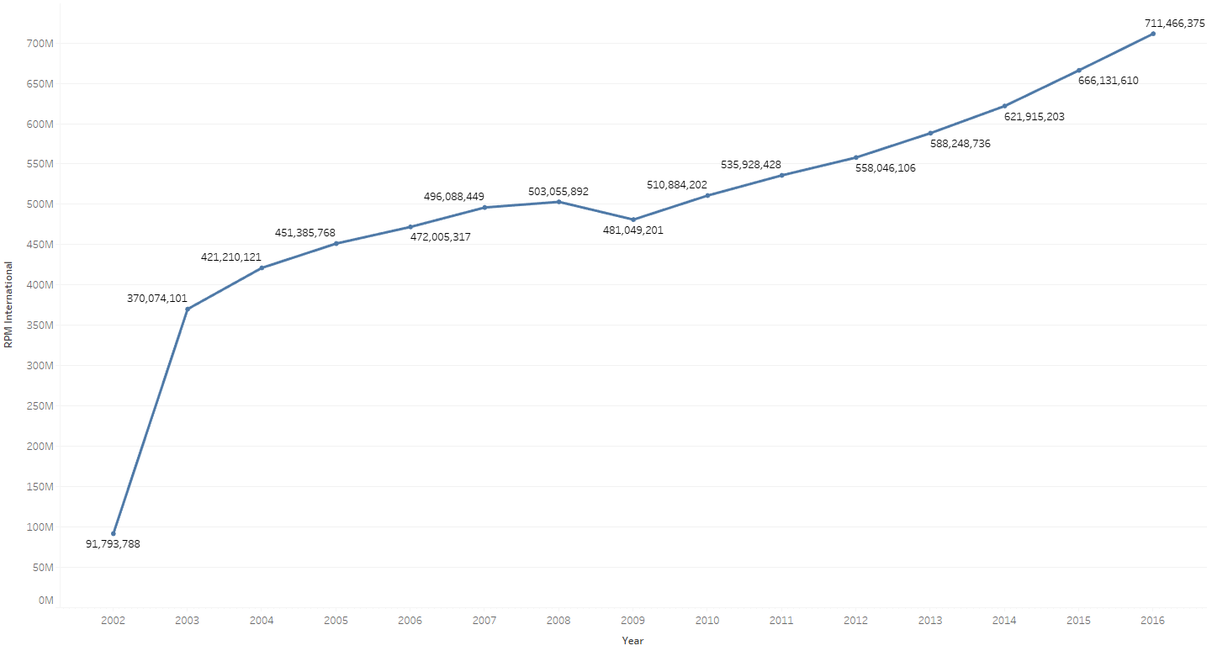
Yearly Revenue Per International Miles
Notes:
Yearly Revenue International Miles Takeaways:
Airline revenue is increasing at a faster rate. The years with lower revenue can be explained with incidents happening in our country. After 9/11 a drastic cut in air travel decreased resulting in less revenue for 2002. In 2009 there was an economic recession. However, revenue for international travel is increasing at a faster rate and has surpassed domestic revenue by approximately $51 Million

Slide 6


Domestic Passengers from 2002-2016
International Passengers from 2002-2016
Notes:
Domestic & International Passengers:
Domestic travelers average 650 Million a year and approximately, 180 Million for international passengers. This graph shows the number of passengers and how they haven’t been discourged from flying.

Slide 7
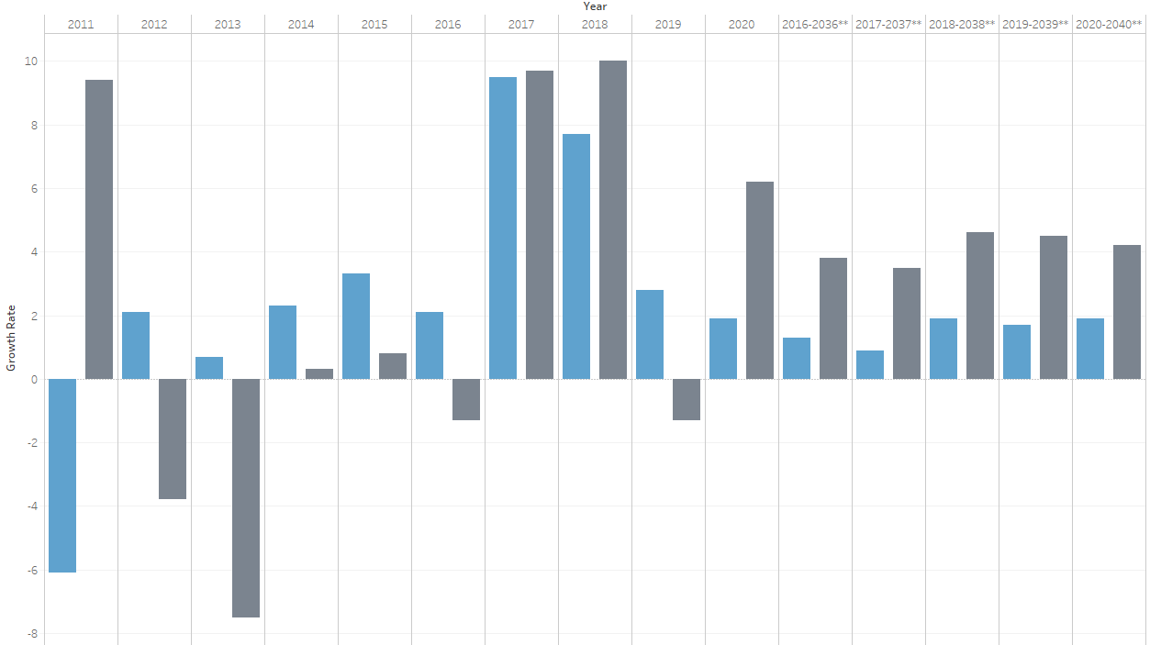

Revenue and Projected Revenue until 2040
Notes:
Projected Revenue Takeaways:
The future of flying is looking bright with projections showing international travel growing about 4% and domestic travel growing at 2% until 2040. These projections demonstrate passengers know airline travel is still a safe way of transportation and feel confident taking trips over seas.

Slide 8
Thank you!
Notes:
I hope this presentation was able to capture how the airline industry is improving and revenues are increasing.
Our goal is to use the knowledge we have gained about passenger preference to improve their flying experience.

